Slide 1



Help us Thank our Sponsors:
NWA TechFest 2010 | Thu, Jul 8th, 2010 | Center for Nonprofits @ St. Mary’s – Rogers, AR | 25+ Speakers & 8 Tracks

Slide 2
Visual studio 2010 web.config transformation
Jay W. Smith
Lead Programmer Analyst
Tyson Foods, Inc.
NWA TechFest 2010 | Thu, Jul 8th, 2010 | Center for Nonprofits @ St. Mary’s – Rogers, AR | 25+ Speakers & 8 Tracks

Slide 3
Please Be Courteous!
NWA TechFest 2010 | Thu, Jul 8th, 2010 | Center for Nonprofits @ St. Mary’s – Rogers, AR | 25+ Speakers & 8 Tracks

Slide 4
Agenda
The Corporate Development Environment
Deployment Challenges
Deployment Strategy 1
Deployment Strategy 2
Xml Data Transformation
Resources
NWA TechFest 2010 | Thu, Jul 8th, 2010 | Center for Nonprofits @ St. Mary’s – Rogers, AR | 25+ Speakers & 8 Tracks
Notes:
This slide is recommended first slide to go over your objectives for the session.

Slide 5






The Corporate Dev Environment
IIS7
Developer
Development
IIS7
Test
IIS7
IIS7
Stage
Production

Slide 6
Deployment Challenges
Database Connection Strings
Membership and Role Configurations
Web Service Endpoints
System Integration Points
Shared Assemblies
Third Party Controls
IIS Settings
File System Paths or File Shares
NWA TechFest 2010 | Thu, Jul 8th, 2010 | Center for Nonprofits @ St. Mary’s – Rogers, AR | 25+ Speakers & 8 Tracks
Notes:
Estimation approaches
There are many ways of categorizing estimation approaches, see for example ^{[9][10]}. The top level categories are the following:
Expert estimation: The quantification step, i.e., the step where the estimate is produced based on judgmental processes.
Formal estimation model: The quantification step is based on mechanical processes, e.g., the use of a formula derived from historical data.
Combination-based estimation: The quantification step is based on a judgmental or mechanical combination of estimates from different sources.
Below are examples of estimation approaches within each category.
Analogy-based estimation Formal estimation model ANGEL
WBS-based (bottom up) estimation Expert estimation MS Project, company specific activity templates Parametric models Formal estimation model COCOMO, SLIM, SEER-SEM
Size-based estimation models^{[11]} Formal estimation model Function Point Analysis^{[12]}, Use Case Analysis, Story points-based estimation in Agile software development
Group estimation Expert estimation Planning poker, Wideband Delphi
Mechanical combination Combination-based estimation Average of an analogy-based and a Work breakdown structure-based effort estimate
Judgmental combination Combination-based estimation Expert judgment based on estimates from a parametric model and group estimation

Slide 7
Multiple Configuration Files
Maintain complete separate configuration files, once for each targeted environment and use ms builds to deploy the correct configuration file based on the build target.
NWA TechFest 2010 | Thu, Jul 8th, 2010 | Center for Nonprofits @ St. Mary’s – Rogers, AR | 25+ Speakers & 8 Tracks

Slide 8
demo

Slide 9
One Configuration file + Magic
Maintain a single configuration file with entries for each environment and use a string replace custom build task to set the run time environment on the build target.
NWA TechFest 2010 | Thu, Jul 8th, 2010 | Center for Nonprofits @ St. Mary’s – Rogers, AR | 25+ Speakers & 8 Tracks

Slide 10
demo
NWA TechFest 2010 | Thu, Jul 8th, 2010 | Center for Nonprofits @ St. Mary’s – Rogers, AR | 25+ Speakers & 8 Tracks

Slide 11
Visual Studio 2010 Solution
Maintain a single configuration file
Use transformation files for each environment
Transformation files only contain the things that change
Works with new MS Deploy
No custom build task
NWA TechFest 2010 | Thu, Jul 8th, 2010 | Center for Nonprofits @ St. Mary’s – Rogers, AR | 25+ Speakers & 8 Tracks
Notes:
This slide is recommended as a final slide to recap the objectives of the session to remind attendees what you said would be covered and to highlight that you did indeed cover those points. The objectives listed on this slide should match the objectives covered on the required Objective slide at the beginning of your presentation.

Slide 12





Web Config Transformations
XML Transformation Engine
(Staging Ready)
Web.Staging.Config

Slide 13
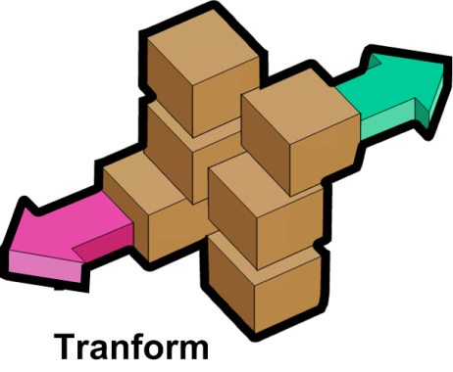
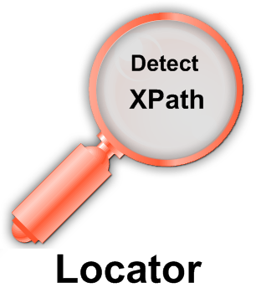

XML Transformation Engine
Web.Staging.Config
(Staging Ready)

Slide 14
demo
NWA TechFest 2010 | Thu, Jul 8th, 2010 | Center for Nonprofits @ St. Mary’s – Rogers, AR | 25+ Speakers & 8 Tracks

Slide 15
Summary
MS Build with Visual Studio 2008 can be used to automate your build and deployment
Visual Studio 2010 deployment story is much better

Slide 16
Related Content
MS Build Reference http://bit.ly/94JsqZ
VS Execute CMD http://devlinliles.com
http://microsoftpdc.com/Sessions/FT56
MSDN Web.config Transformation Syntax http://bit.ly/a2J8vA
http://delicious.com/jay.smith/WebConfigTransformation
NWA TechFest 2010 | Thu, Jul 8th, 2010 | Center for Nonprofits @ St. Mary’s – Rogers, AR | 25+ Speakers & 8 Tracks
Notes:
16
Speakers should use this slide to identify content, related to their presentation, being offered in other sessions.
If there is additional content available that attendees should know about, please add a section for Additional Resources to the slide. In this section you can call out whitepapers or websites that you and your team have created.

Slide 17
Please Complete An Evaluation Form Your input is important!
Multiple ways to access Evaluation Forms:
Registration stations
From any wired or wireless connection to: http://NWATechFest.com
1.
2.
NWA TechFest 2010 | Thu, Jul 8th, 2010 | Center for Nonprofits @ St. Mary’s – Rogers, AR | 25+ Speakers & 8 Tracks

Slide 18
Help us Thank our Sponsors:
NWA TechFest 2010 | Thu, Jul 8th, 2010 | Center for Nonprofits @ St. Mary’s – Rogers, AR | 25+ Speakers & 8 Tracks

